Slide 1

Iteration 2
Computer Science Project Portal

Slide 2
USER STORIES
Iteration 1
Iteration 2
Add Project
MVP
Implemented
Add
Validation
View Projects
MVP
Implemented
Tested and Validated
Remove Project
MVP Implemented
Search for Project
MVP Implemented

Slide 3
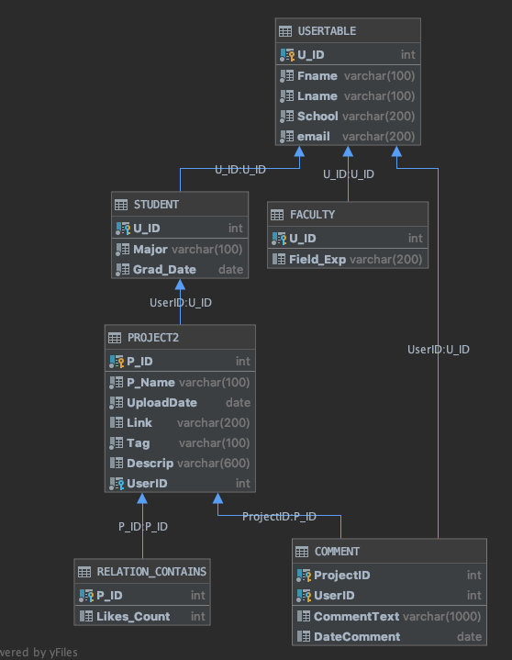
DESIGN ARCHITECTURE
DB Architecture fully implemented in MS SQL Server
Developed and implemented constraints to avoid data anomalies
Sample tuples created to display functionality
Pending SQL Unit Testing with tuples

Slide 4
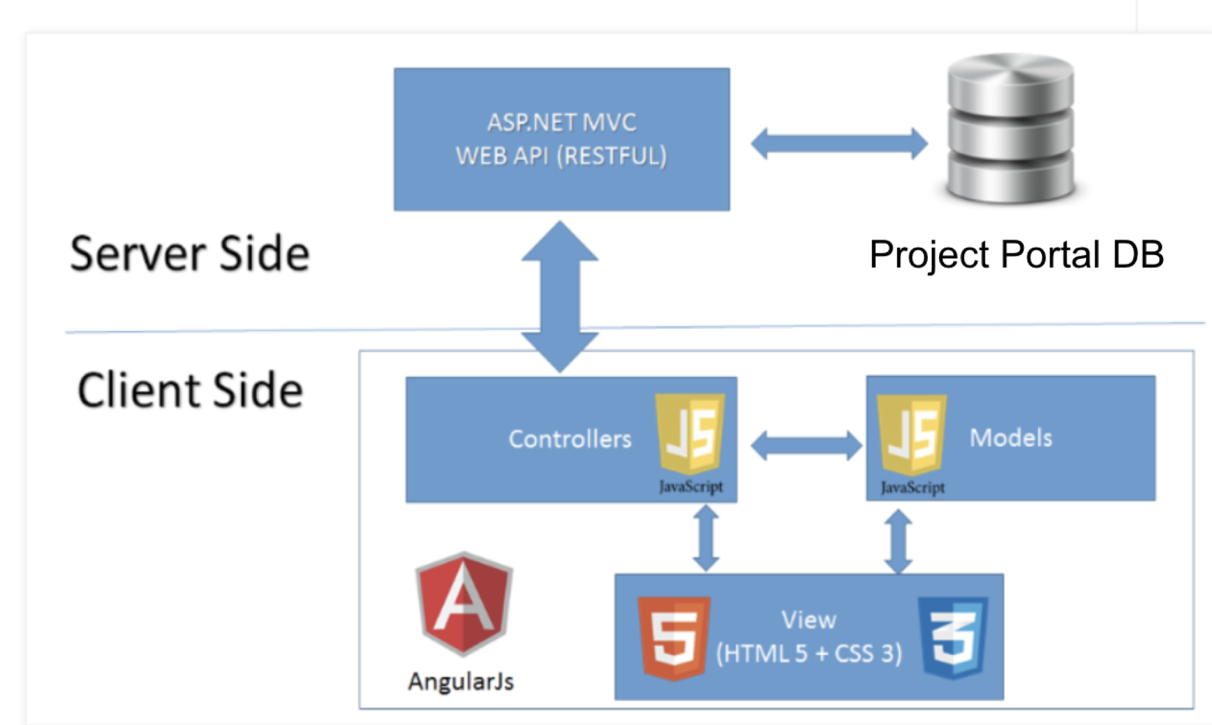
SITE ARCHITECTURE

Slide 5
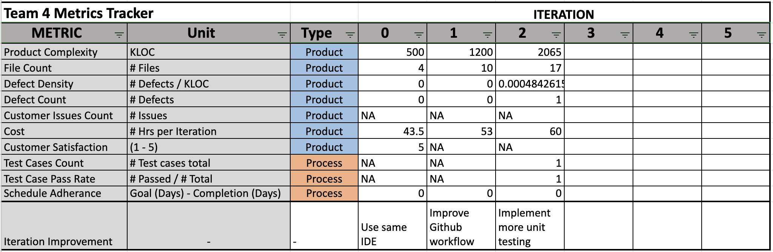
QUALITY METRICS SUMMARY
Notes:
Red cells need be updated

Slide 6
UI DESIGN
Interface:
Re-styling layout with bootstrap.
Adding a new javascript file to add behavior in a sign up page.
Adding new html section with razor file for add, project list and search page.
Testing html file with .cshtml (Razor file)

Slide 7
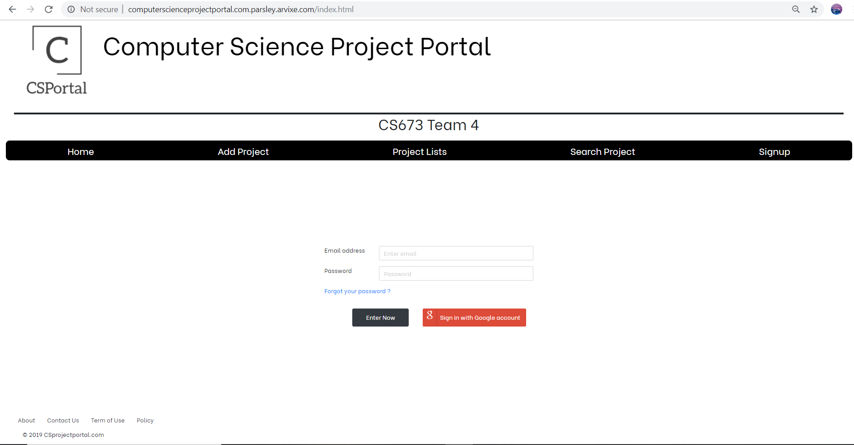

Slide 8
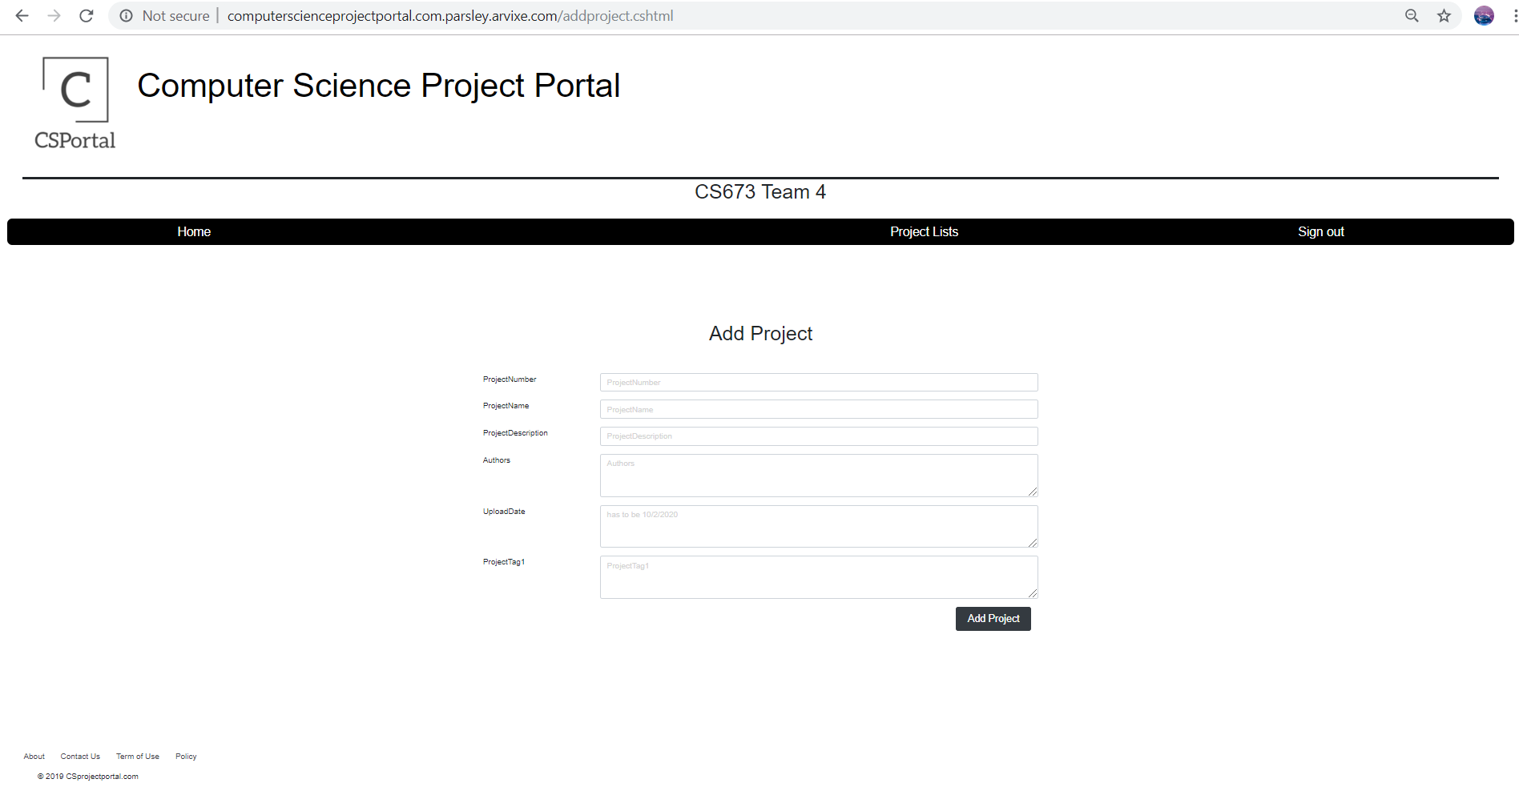

Slide 9
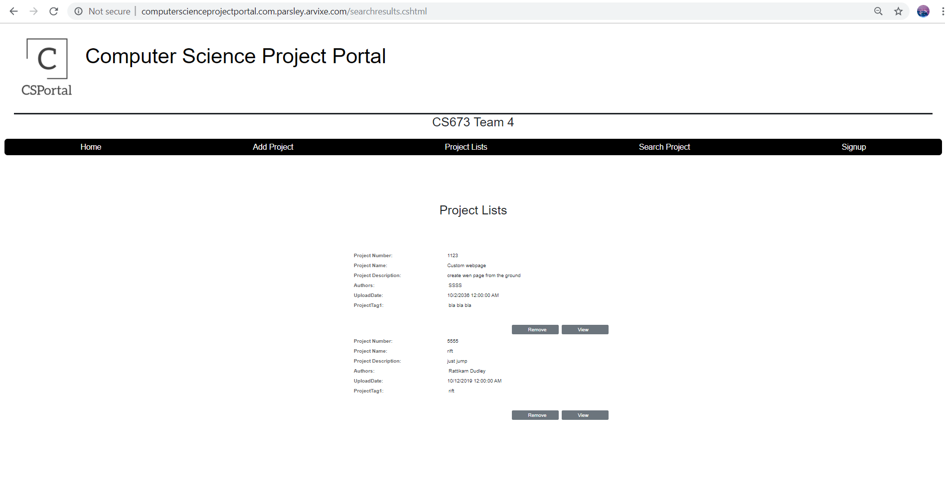

Slide 10
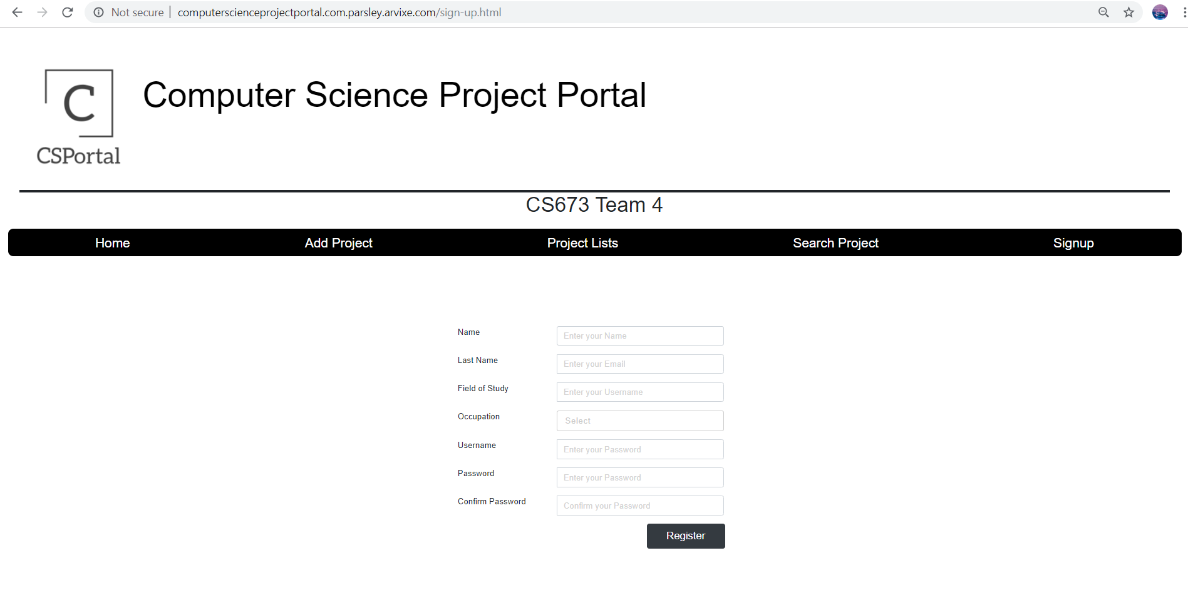

Slide 11
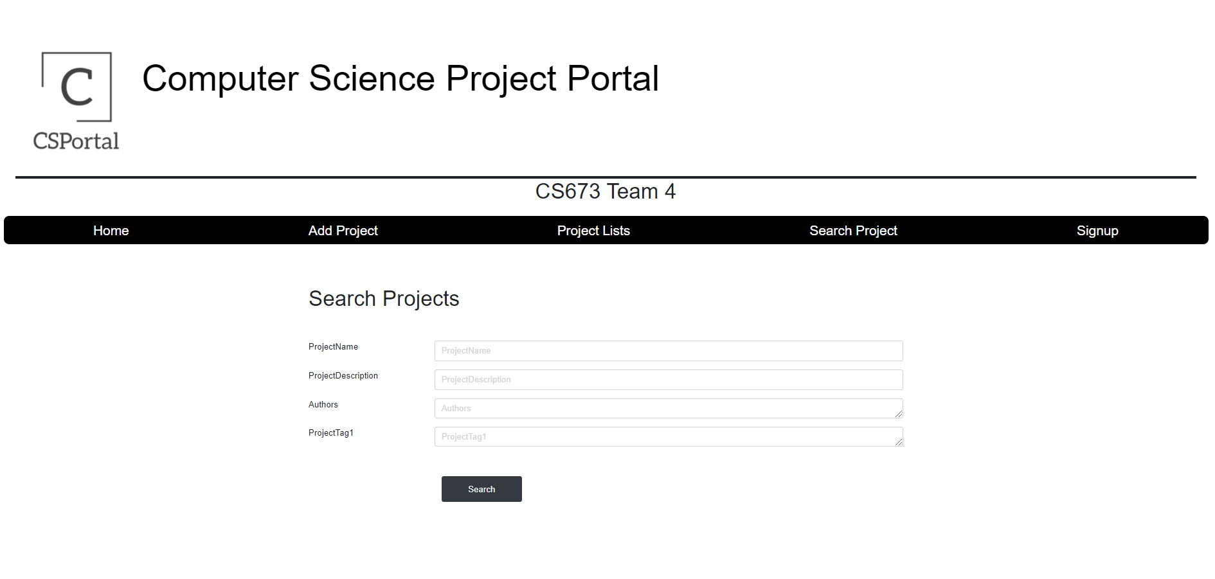

Slide 12
BACKEND IMPLEMENTATION
Add Project
Grab all parameters from input boxes, and include them in a sql insert statement.
db.Execute(insertQuery, ProjectNumber, ProjectName, ProjectDescription, Authors, UploadDate, ProjectTag1);
Remove and View project buttons in a list
C# has method to pull strings from an attribute of an html button.
As the page loads list of projects each button gets that project’s ID.
Within that button’s name attribute is also whether it is a delete or view button
name="ProjectNumberRemove=@row.ProjectNumber"
name="ProjectNumberView=@row.ProjectNumber"
C# then sparses that string out to decide what to do.
var buttonsProjectId = Request.Params.AllKeys.FirstOrDefault(key => key.StartsWith("ProjectNumber"));
Search Results
On Submit, gather data from input boxes
Redirect to a URL with the variables:
Response.Redirect(BaseResponseRedirectString+ProjectNameURL+ProjectDescriptionURL+AuthorsURL+ProjectTag1URL);
Opening a new page, it gathers the variables from the URL to build the sql querey.
Request.QueryString.Get("authors");

Slide 13
MANAGEMENT
Next-Iteration
Project management and progress tracking with pivotal tracker
Adding Login and Logout implementation
Adding Sign up implementation
Improving a search functionality.
Adding responsive design to mobile and ipad screen.

